Slide 1
Pac-Man Project
OOP class S1 24-25

Slide 2
About Us
Group members:
Trần Khánh Tài: ITITIU21300
Trần Khôi Nguyên: ITITIU264
Mai Đức Thiện: ITITIU319
Huỳnh Đạt Minh Tâm: ITITIU21305

Slide 3
Table of Contents
01
02
03
Introduction
Method and algorithms
Result and conclusion

Slide 4
Introduction
01

Slide 5
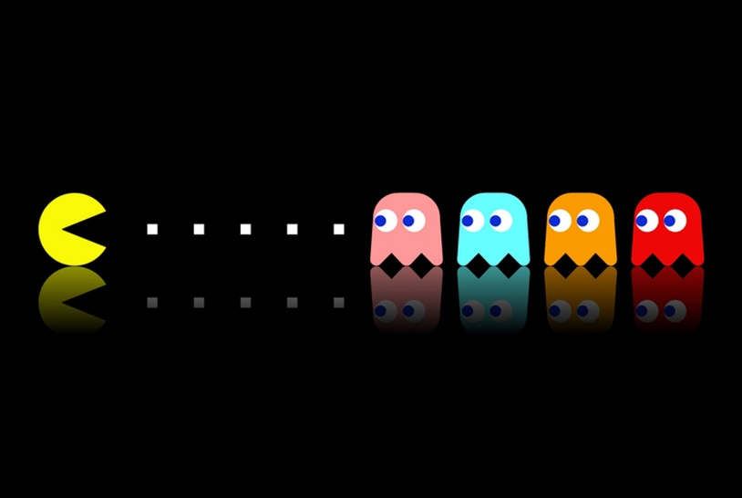
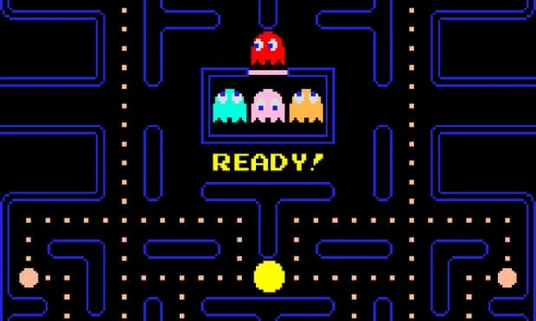
Game play
Pac-Man is a 1980 maze video game developed and released by Namco for arcades. In North America, the game was released by Midway Manufacturing as part of its licensing agreement with Namco America
The player navigates Pac-Man through a maze with no dead ends. The maze is filled with Pac-Dots, and includes four roving multi-colored ghosts: Blinky, Pinky, Inky and Clyde

Slide 6
“
AIM
The aim of Pac-Man is to eat all of dots. Its may seem easy, buts it is not as simple as it seems- the task is may difficult because four ghosts. They are trying to catch Pac-man. And when one of them touches Pac-man, a life is lose
“

Slide 7
UML Diagram

Slide 8
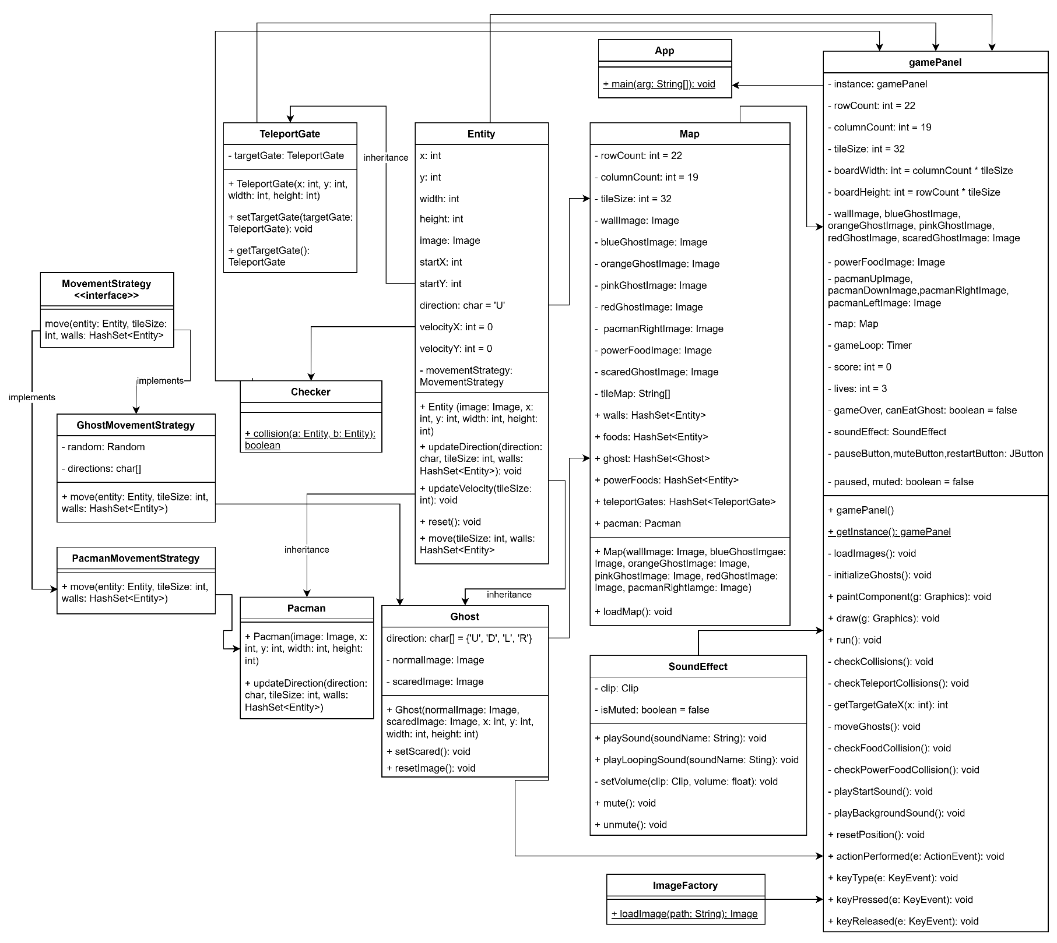

Slide 9
Method and algorithms
02

Slide 10
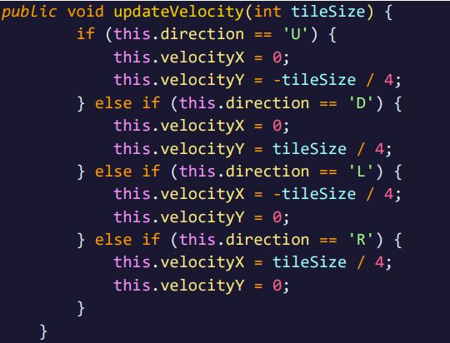
Update Velocity Algorithm
Here we use tileSize / 4 instead of tileSize, because we want to control the speed of movement for the entity in the game.
The tileSize stands for the size of one tile in grid. If the velocity we set to tileSize, each time we call this method Pac-man will move a full tile for each update, it make us feel like Pac-man is teleporting.

Slide 11
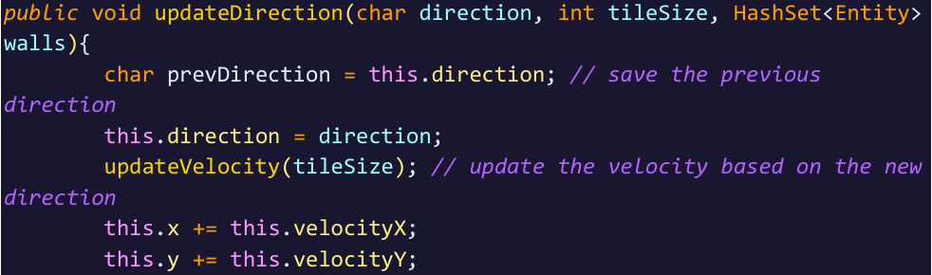
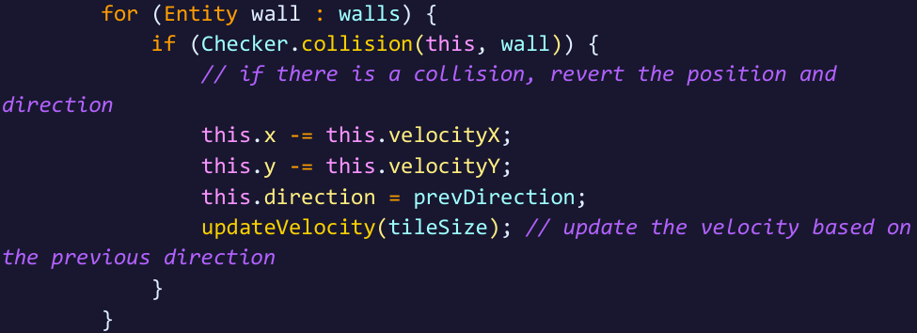
Update Direction Algorithm
We save the current direction of the entities to prevDirection, then update the direction of the entities. After that we update the velocity of entities based on the new direction.
We check for collisions with walls. If a collision is detected, the entities position is revered by subtracting the velocity from its coordinates, and set the direction to prevDirection.

Slide 12
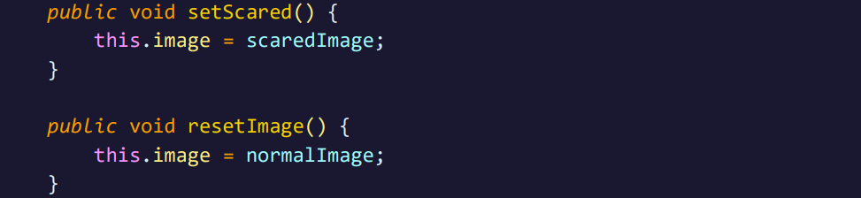
setScared() method and resetImage() method
We need to set the ghost’s image to scary after Pac-man eat power food. Then, after 7 seconds we will call resetImage() method to reset ghost’s image to normal.

Slide 13
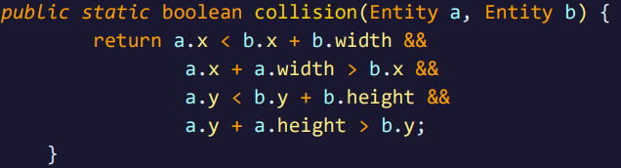
Checker
The collision method of Checker class checks if two entities are colliding. This work by comparing their position and dimension.
We use axis-aligned bounding box algorithms to determine of two entities overlapping.

Slide 14
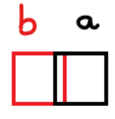
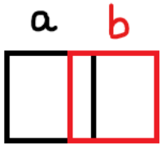
Checker Algorithm
a.x < b.x + b.width : check if the left side of a is to the left of the right side of b.
a.x + a.width > b.x: check if the right side of a is to the right of left side of b

Slide 15
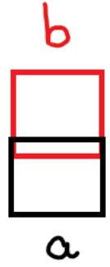
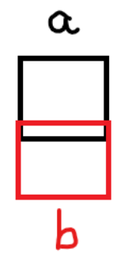
a.y < b.y + b.height: check if the top side of a is above the bottom side of b.
a.y + a.height > b.y: check if the bottom side of a is below the top side of b.
If all these conditions are true, it means that the rectangle of entities are overlapping, indicating a collision.

Slide 16
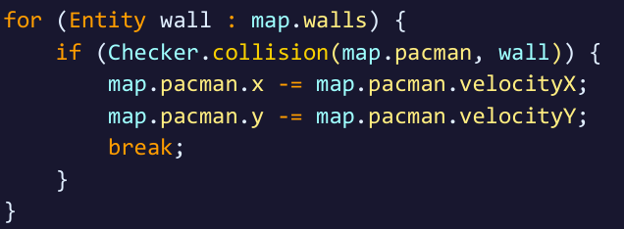
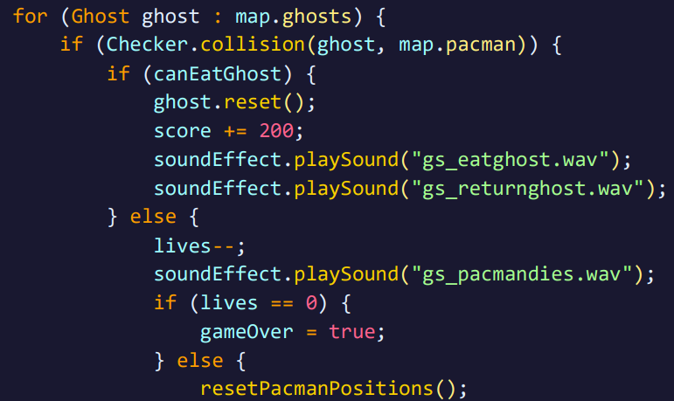
Check Collision Algorithms
Pac-man can’t go over the edge of the map and can’t eat ghosts in normal condition.
Using Checker class to check the collision between Pac-man and other entities. If Pac-man collides with walls, we will reverse Pac-man to the last position. Besides, if Pac-man collides with Ghost, the first thing we do is check if canEatGhost is false or true.

Slide 17
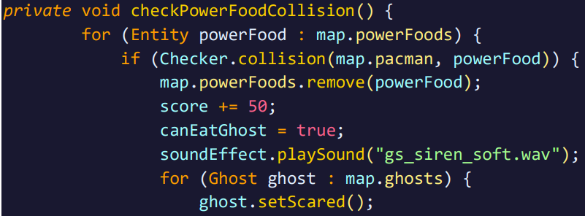
Checking collides with Power Foods Algorithm
After Pac-man eat power food, we give Pac-man a special ability that can eat Ghost. So, we need to add some algorithms for that.
Firstly, after eating power food we set the value of canEatGhost to true, then set the image of Ghosts to scared ghost by using setScared() method in Ghost class.

Slide 18
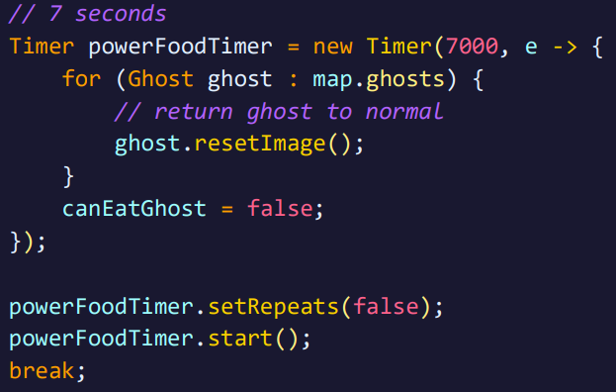
Secondly, we need a Timer to count the time that Pac-man can eat Ghosts, here we set the timer to 7000 milliseconds, after 7 seconds we will bring them back to normal, using resetImage() method, and set canEatGhost to false.

Slide 19
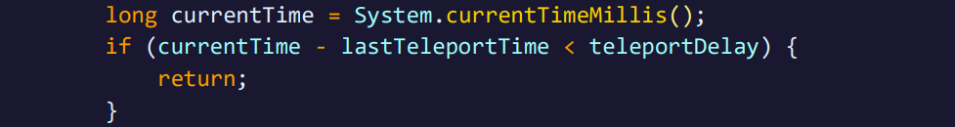
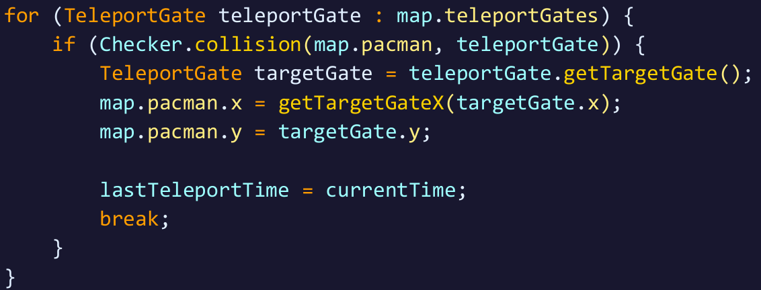
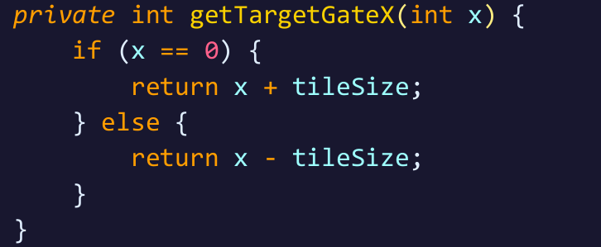
Check Teleport Collision
We set lastTeleportTime to zero, and a fixed variable to control the time between two times of teleport, teleportDelay, to 200 milliseconds (0.2 seconds).
Secondly, if a collision is detected, we will retrieves the targetGate of the current teleport gate using getTargetGate() method. Then we updated the position of Pac-man to the target gate position.

Slide 20
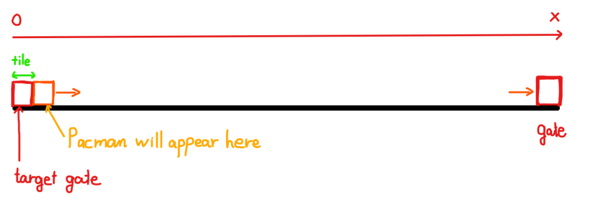
This method adjusts the x-coordinate of target gate to ensure Pac-man is correctly positioned. For example, if the target x-coordinate is zero, we will add tileSize.
Here we set:
So, if the x-coordinate of target gate is zero, Pac-man will appear at x = 0 + 32, otherwise x = x – 32

Slide 21
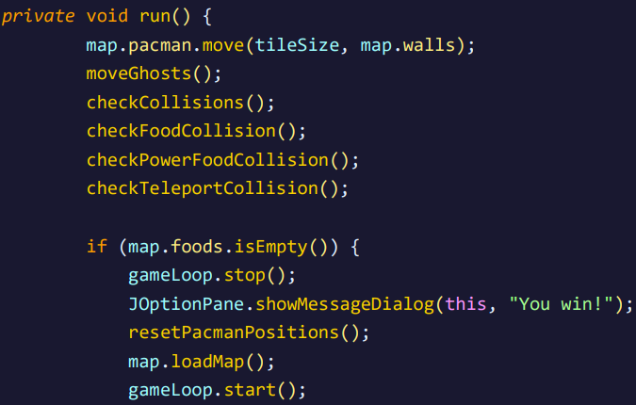
Run game method
The run() method executed the main game logic like move Pac-man, move Ghosts, check for various collisions, and check of the food is empty, it stop the game loop and show a “You win!” message, reset Pac-man position, reloads the map, and restart the game loop

Slide 22
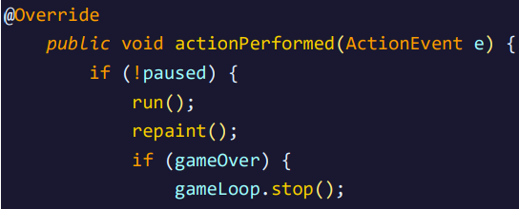
An override method actionPerformed handle actions events by running the game logic, repaint the game panel, and stop the game loop if the game is over.

Slide 23
Conclusion
03

Slide 24
Conclusion
Pac-man Game that was build by Object-oriented programming method is more easier and logical than the traditional method. This shows clearly polymorphism, inheritance, encapsulation, abstraction of OOP, and the relationship between classes and objects is linked tightly and systematically.
Besides that, learning more knowledge outside the limits of this course is one of the important things to do while performing this project.

Slide 25
